Slide 1
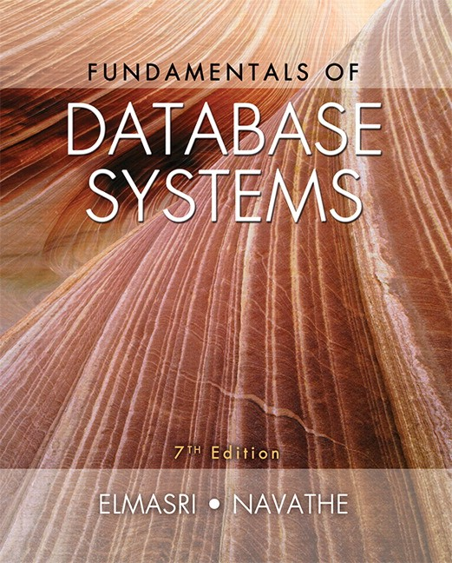

Slide 2
CHAPTER 19
Query Optimization

Slide 3
Introduction
Query optimization
Conducted by a query optimizer in a DBMS
Goal: select best available strategy for executing query
Based on information available
Most RDBMSs use a tree as the internal representation of a query

Slide 4
19.1 Query Trees and Heuristics for Query Optimization
Step 1: scanner and parser generate initial query representation
Step 2: representation is optimized according to heuristic rules
Step 3: query execution plan is developed
Execute groups of operations based on access paths available and files involved

Slide 5

Query Trees and Heuristics for Query Optimization (cont’d.)
Example heuristic rule
Apply SELECT and PROJECT before JOIN
Reduces size of files to be joined
Query tree
Represents relational algebra expression
Query graph
Represents relational calculus expression
Example for Q2 on next slide

Slide 6
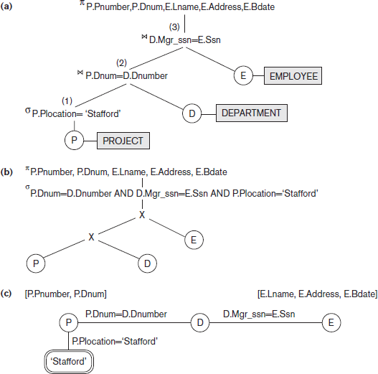
Query Trees and Query Graph Corresponding to Q2
Figure 19.1 Two query trees for the query Q2. (a) Query tree corresponding to the relational algebra expression for Q2. (b) Initial (canonical) query tree for SQL query Q2. (c) Query graph for Q2.

Slide 7
Query Trees and Heuristics for Query Optimization (cont’d.)
Query tree represents a specific order of operations for executing a query
Preferred to query graph for this reason
Query graph
Relation nodes displayed as single circles
Constants represented by constant nodes
Double circles or ovals
Selection or join conditions represented as edges
Attributes to be retrieved displayed in square brackets

Slide 8
Heuristic Optimization of Query Trees
Many different query trees can be used to represent the query and get the same results
Figure 19.1b shows initial tree for Q2
Very inefficient - will never be executed
Optimizer will transform into equivalent final query tree

Slide 9

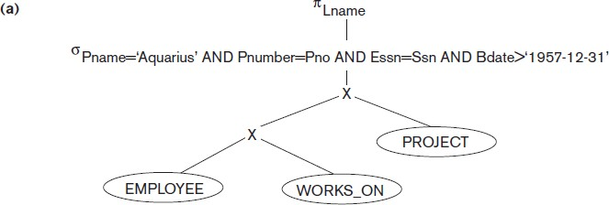
Query Transformation Example
Figure 19.2 Steps in converting a query tree during heuristic optimization. (a) Initial (canonical) query tree for SQL query Q.

Slide 10
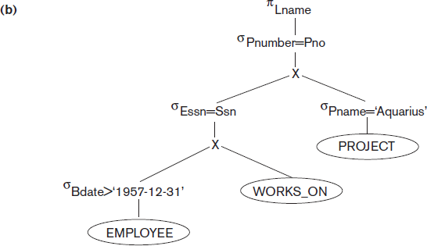
Query Transformation Example (cont’d.)
Figure 19.2 Steps in converting a query tree during heuristic optimization
(b) Moving SELECT operations down the query tree.

Slide 11
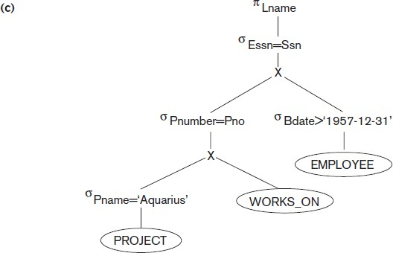
Query Transformation Example (cont’d.)
Figure 19.2 Steps in converting a query tree during heuristic optimization
(c) Applying the more restrictive SELECT operation first.
Slide 19- 11

Slide 12
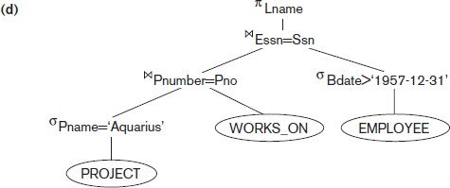
Query Transformation Example (cont’d.)
Figure 19.2 Steps in converting a query tree during heuristic optimization
(d) Replacing CARTESIAN PRODUCT and SELECT with JOIN operations.
Slide 19- 12

Slide 13
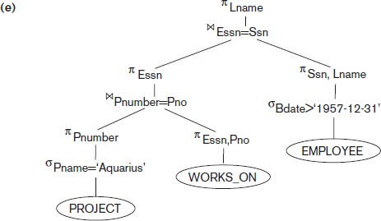
Query Transformation Example (cont’d.)
Figure 19.2 Steps in converting a query tree during heuristic optimization
(e) Moving PROJECT operations down the query tree.

Slide 14
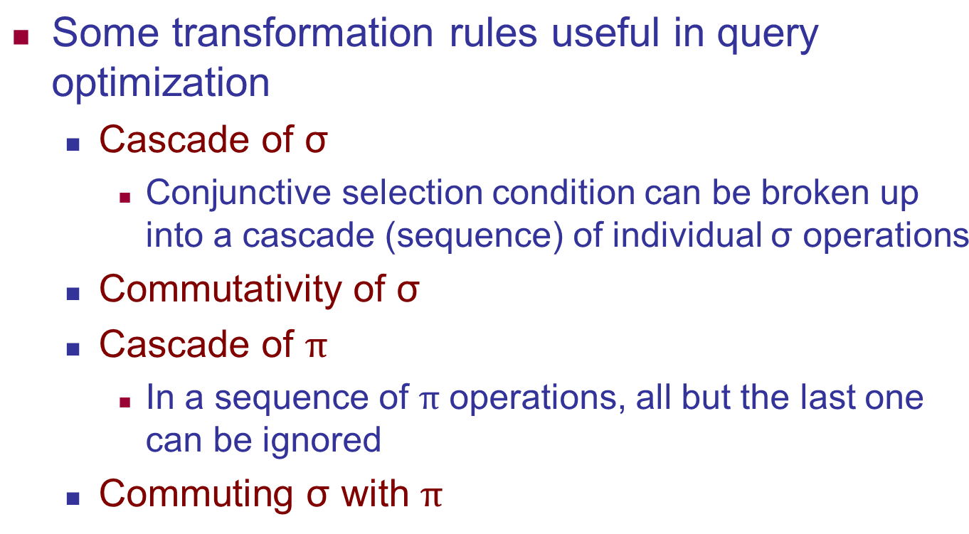
General Transformation Rules for Rational Algebra Equations
■

Slide 15
Summary of Heuristics for Algebraic Optimization
Apply first the operations that reduce the size of intermediate results
Perform SELECT and PROJECT operations as early as possible to reduce the number of tuples and attributes
The SELECT and JOIN operations that are most restrictive should be executed before other similar operations

Slide 16
19.2 Choice of Query Execution Plans
Materialized evaluation
Result of an operation stored as temporary relation
Pipelined evaluation
Operation results forwarded directly to the next operation in the query sequence

Slide 17
Nested Subquery Optimization
Unnesting
Process of removing the nested query and converting the inner and outer query into one block
Queries involving a nested subquery connected by IN or ANY connector can always be converted into a single block query
Alternate technique
Creating temporary result tables from subqueries and using them in joins

Slide 18
19.3 Use of Selectives in Cost-Based Optimization
Query optimizer estimates and compares costs of query execution using different strategies
Chooses lowest cost estimate strategy
Process suited to compiled queries

Slide 19
Use of Selectives in Cost-Based Optimization (cont’d.)
Cost-based query optimization approach
For a given query subexpression, multiple equivalence rules may apply
Quantitative measure for evaluating alternatives
Cost metric includes space and time requirements
Design appropriate search strategies by keeping cheapest alternatives and pruning costlier alternatives
Scope of query optimization is a query block
Global query optimization involves multiple query blocks

Slide 20
Use of Selectives in Cost-Based Optimization (cont’d.)
Cost components for query execution
Access cost to secondary storage
Disk storage cost
Computation cost
Memory usage cost
Communication cost

Slide 21
Catalog Information Used in Cost Functions
Information stored in DBMS catalog and used by optimizer
File size
Organization
Number of levels of each multilevel index
Number of distinct values of an attribute
Attribute selectivity
Allows calculation of selection cardinality
Average number of records that satisfy equality selection condition on that attribute

Slide 22
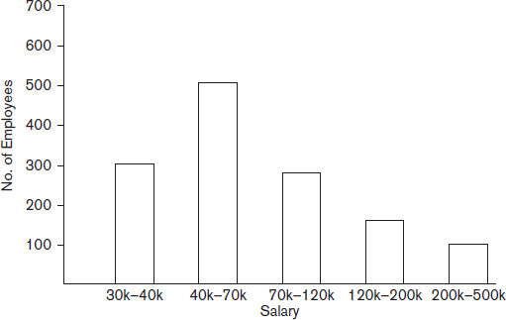
Histograms
Tables or data structures that record information about the distribution of data
RDBMS stores histograms for most important attributes
Figure 19.4 Histogram of salary in the relation EMPLOYEE

Slide 23
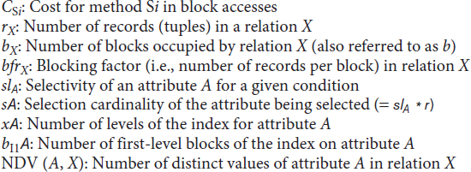
19.4 Cost Functions for SELECT Operation
Notation used in cost formulas

Slide 24
Cost Function for SELECT Operation (cont’d.)
S1: Linear search (brute force approach)
Search all file blocks to retrieve all records
C_{S1a}=b
For equality condition on a key attribute, on average one-half the records are searched
₌!
C
S1b
"
S2: Binary search
C =log b+[ # ]-1
S2 2
!$%
Reduces to log₂b if equality condition is on a key attribute

Slide 25
Cost Function for SELECT Operation (cont’d.)
S3a: Using a primary index to retrieve a single record
C_{S3a} = x + 1
S3b: Using a hash key to retrieve a single record
C_{S3b} = 1
S4: Using an ordering index to retrieve multiple records
C = x + !
S4
"

Slide 26
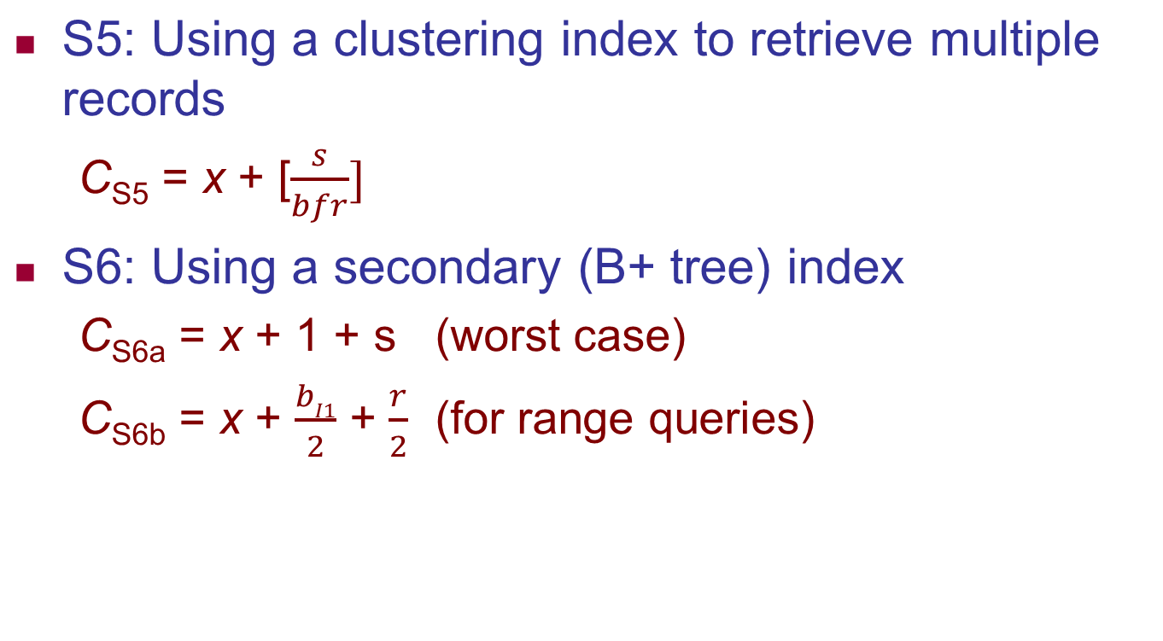
Cost Functions for SELECT Operation (cont’d.)
■

Slide 27
Cost Functions for SELECT Operation (cont’d.)
Dynamic programming
Cost-based optimization approach
Subproblems are solved only once
Applies when a problem has subproblems that themselves have subproblems

Slide 28
19.5 Cost Functions for the JOIN Operation
Cost functions involve estimate of file size that results from the JOIN operation
Join selectivity
Ratio of the size of resulting file to size of the CARTESIAN PRODUCT file
Simple formula for join selectivity
Join cardinality

Slide 29

Cost Functions for the JOIN Operation (cont’d.)
J1: Nested-loop join
For three memory buffer blocks:
For n_{B} memory buffer blocks:
J2: Index-based nested-loop join
For a secondary index with selection cardinality S_{B} for join attribute B of S:

Slide 30
Cost Functions for the JOIN Operation (cont’d.)
J3: Sort-merge join
For files already sorted on the join attributes
Cost of sorting must be added if sorting needed
J4: Partition-hash join

Slide 31


Cost Functions for the JOIN Operation (cont’d.)
Join selectivity and cardinality for semi-join
Unnesting query above leads to semi-join
Join selectivity
Join cardinality

Slide 32
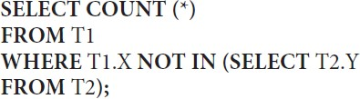


Cost Functions for the JOIN Operation (cont’d.)
Join selectivity and cardinality for anti-join
Unnesting query above leads to anti-join
Join selectivity
Join cardinality

Slide 33
Cost Functions for the JOIN Operation (cont’d.)
Physical optimization involves execution decision at the physical level
Cost-based physical optimization
Top-down approach
Bottom-up approach
Certain physical level heuristics make cost optimizations unnecessary
Example: for selections, use index scans whenever possible

Slide 34
Cost Functions for the JOIN Operation (cont’d.)
Left-deep trees generally preferred
Work well for common algorithms for join
Able to generate fully pipelined plans
Characteristics of dynamic programming algorithm
Optimal solution structure is developed
Value of the optimal solution is recursively defined
Optimal solution is computed and its value developed in a bottom-up fashion

Slide 35

19.6 Example to Illustrate Cost-Based Query Optimization
Example: Consider Q2 below and query tree from Figure 19.1(a) on slide 6
Information about the relations shown in Figure
19.6 (next slide)

Slide 36
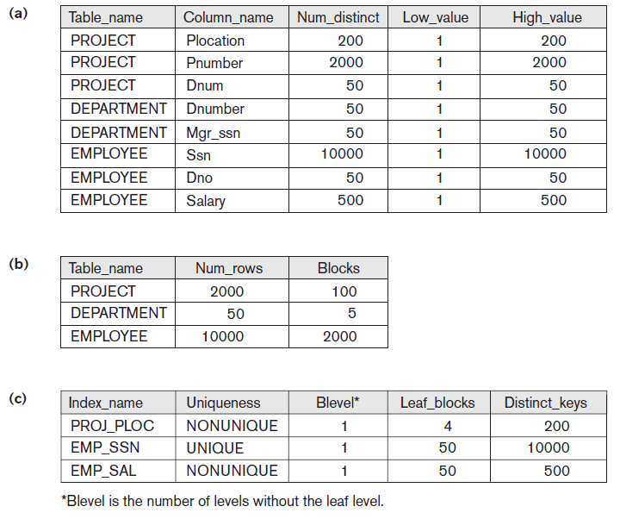
Figure 19.6 Sample statistical information for relations in Q2.
Column information
Table information
Index information

Slide 37
Example to Illustrate Cost-Based Query Optimization (cont’d.)
Assume optimizer considers only left-deep trees
Evaluate potential join orders
PROJECT DEPARTMENT
EMPLOYEE EMPLOYEE PROJECT PROJECT
DEPARTMENT
DEPARTMENT
PROJECT EMPLOYEE
EMPLOYEE DEPARTMENT

Slide 38
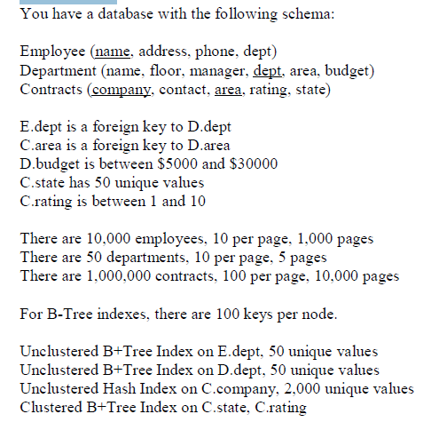
EXERCISE

Slide 39
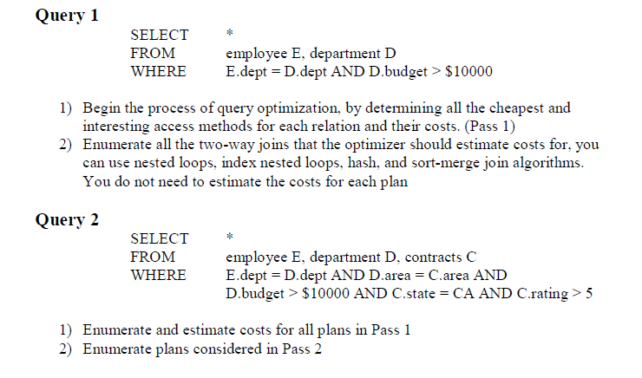

Slide 40
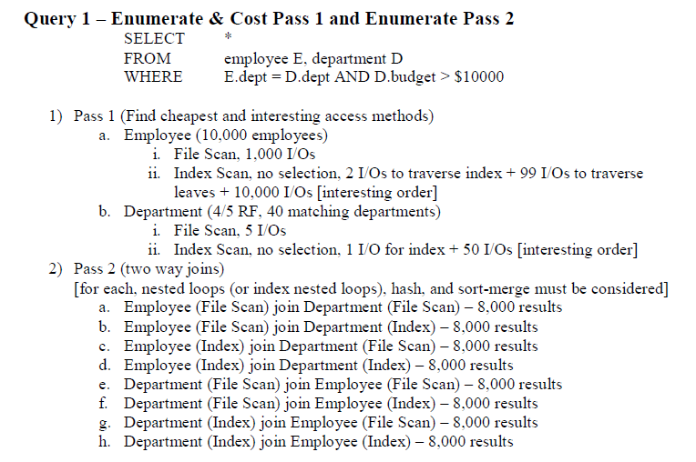

Slide 41
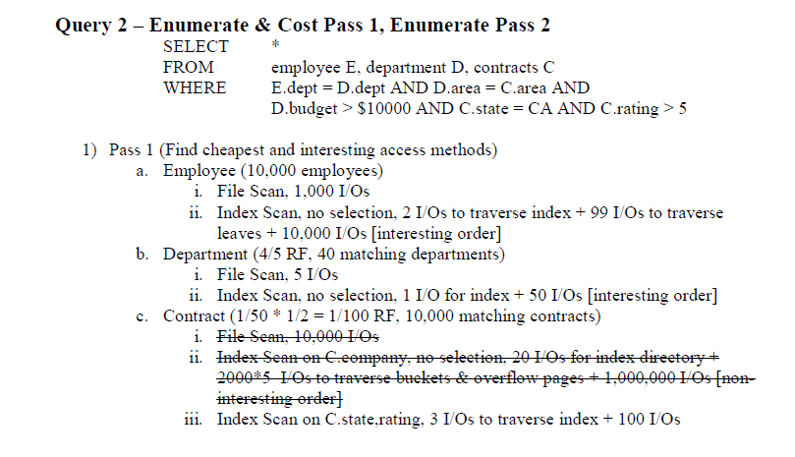

Slide 42
